Slide 1
Measuring Intergroup Reciprocity by Analysis of Tweets
Akshata Patel, Kiran Saini

Slide 2
Introduction
The aim is to measure intergroup reciprocity which is an important factor of peace.
First step is to segment the population into two groups
Second step is to identify twitter interactions
Third step is to quantitatively score interaction based on level of agreement

Slide 3
Methodology
Identify groups: The population is divided into two groups on the basis of political affiliation. The political affiliation of the sample is self identified by membership to official Twitter accounts of the Democrat and Republican party.
Identify Twitter interactions: Three types of interactions are identified between the two groups.
Retweet
Quote
User-mentions

Slide 4
Methodology
3. Create corpus of interaction tweets: Tweepy API is used to extract tweets with the different types of interactions. The political affiliation of the two users involved in each tweet is also stored(Dem->Dem, Dem->Rep, Rep->Dem, Rep->Rep
4. Analysis of tweets: Each interaction is classified as Agreement/Disagreement.
Each retweet is classified as an agreement
A classification model is used to classify quotes
Sentiment analysis is used to classify tweets with user mentions

Slide 5
Methodology
5. Scoring of interactions: For each type of interaction(Dem->Dem, Rep->Rep, Rep->Dem, Dem->Rep) the count of interactions with class agreement and class disagreement is calculated.
The score of positive intergroup reciprocity is taken as the proportion of interactions with class agreement
The score of negative intergroup reciprocity is taken as the proportion of interactions with class disagreement

Slide 6
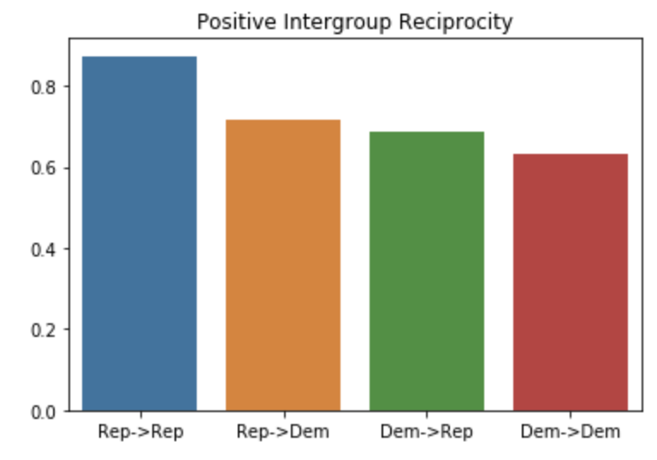
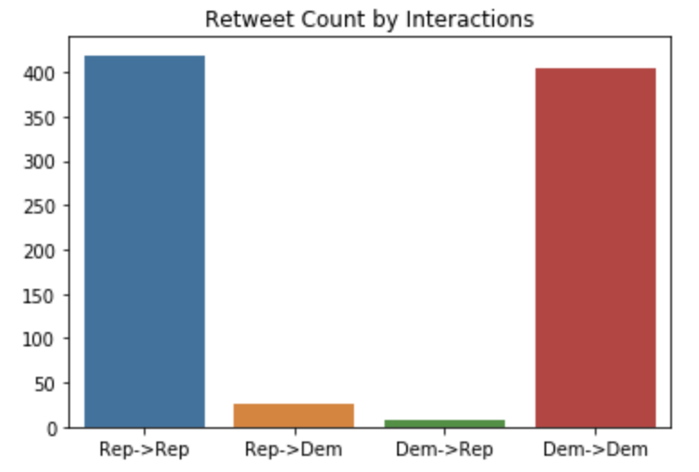
Results
Figure 1: Positive intergroup reciprocity
Figure 2: The retweet counts by interaction type

Slide 7
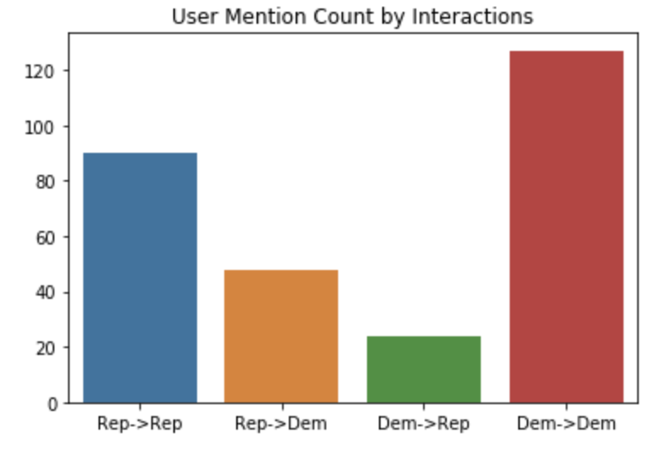
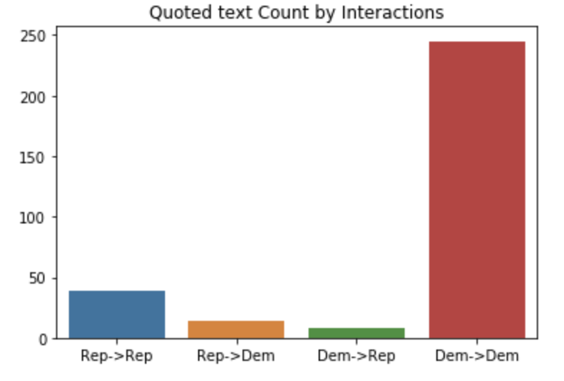
Results
Figure 3: Count of tweets with user-mentions by interaction type
Figure 4: The quote counts by interaction type

Slide 8
Thank You!

